Slide 1
Project Presentation of Back End Engineering Project (BEE) (22CS026)
On
<Title of the Project>
<Name of the Student>
<Roll Number>
Supervised By
<Name of the Mentor/Team Lead/Manager>
Department of Computer Science and Engineering,
Chitkara University, Punjab

Slide 2
Contents
Introduction
Problem Statement
Objective of the Study
Label Noise (Symmetric & Asymmetric)
Datasets Used
Machine Learning Models
Methodology
Performance Metrics
Results & Analysis
Comparison of Models
Conclusion
Future Scope
2

Slide 3
Introduction
Machine learning models depend on correct training data
In real-world datasets, labels are often incorrect
These errors are called label noise
Label noise affects how well a model learns
This study checks how different models behave under
such conditions

Slide 4
Problem Statement
Real datasets are not always perfectly labeled
Models trained on wrong labels learn incorrect patterns
This leads to poor predictions
Not all models react the same way to noisy data
Need to identify which models handle noise better

Slide 5
Objective of the Study
Study how models perform when labels are incorrect
Compare different machine learning models
Analyze impact of different types of noise
Evaluate performance using proper metrics
Find models that remain stable under noise

Slide 6
Overview of Label Noise
Label noise = incorrect or misleading labels in data
It affects the learning process directly
Two main types:
Symmetric noise → random errors
Asymmetric noise → structured errors
Helps simulate real-world imperfect data

Slide 7
Datasets Used
Two datasets were used:
Breast Cancer Datase
Small and clean dataset
Mostly numerical features
2. Adult Income Dataset
Large and complex dataset
Mixed features and class imbalance
Using two datasets improves reliability

Slide 8
Machine Learning Models
Six models were tested:
Logistic Regression
Decision Tree
Random Forest
SVM
KNN
LightGBM
Each model follows a different learning approach
Helps compare different types of behavior

Slide 9
Methodology
Data split into training and testing sets
Noise added only to training labels
Testing done on clean data
Different noise levels: 0%, 10%, 20%, 30%
5-fold cross-validation used for stability

Slide 10
Performance Metrics
Accuracy
Measures overall correct predictions
F1-score
Balances precision and recall
Useful for imbalanced data
Both metrics used for better evaluation

Slide 11
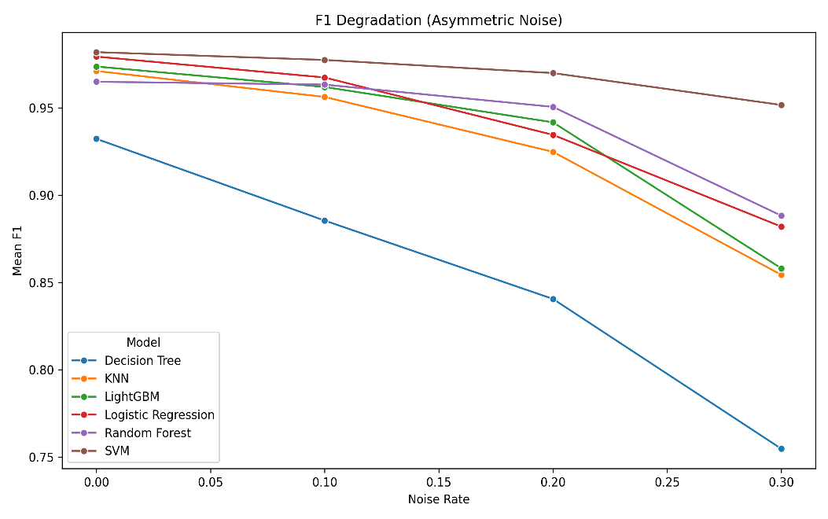
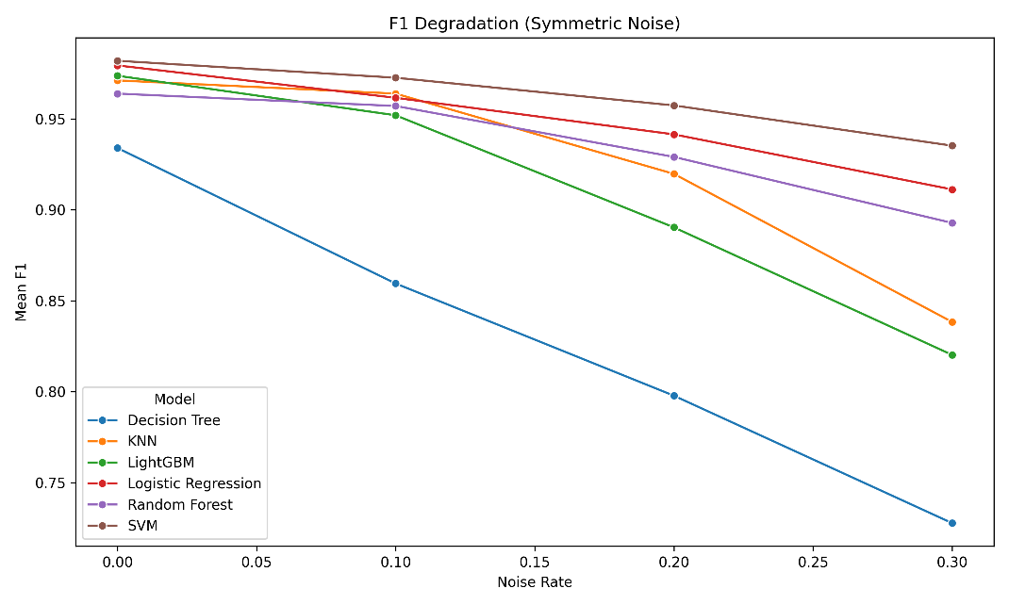
Results (Key Observations)
Performance decreases as noise increases
Symmetric noise affects models more
SVM performs consistently well
Decision Tree performs worst under noise
Results vary across datasets

Slide 12
Accuracy vs F1-score
Accuracy may remain stable even with noise
F1-score shows deeper performance drop
Especially important for imbalanced data
Using only accuracy can be misleading
Both metrics should be considered

Slide 13
Conclusion & Future Scope
Label noise reduces model performance
Impact depends on model and data
No single model works best in all cases
SVM is strong under random noise
Decision Tree is most sensitive
Future Scope:
Test more datasets
Study advanced noise-handling methods
Include deep learning models

Slide 14
Any Questions ?

Slide 15
Thank You
15

